Slide 1


Deep Unsupervised Learning
Naeemullah Khan
naeemullah.khan@kaust.edu.sa
KAUST Academy
King Abdullah University of Science and Technology

Slide 2
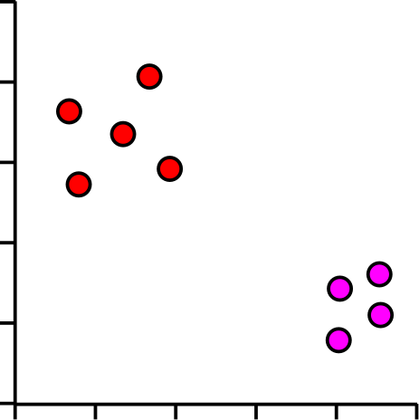
Where are we heading?
Gene | Description | Cell 1 | Cell 2 | Cell 3 | Cell 4 | Cell 5
Inpp5d | inositol polyphosphate-5-phosphatase D | 7.00 | 5.45 | 5.89 | 6.03 | 5.75
Aim2 | absent in melanoma 2 | 3.01 | 4.37 | 4.59 | 4.38 | 4.18
Gldn | gliomedin | 3.48 | 3.63 | 4.61 | 4.70 | 4.74
Frem2 | Fras1 related extracellular matrix protein 2 | 4.75 | 4.66 | 3.46 | 3.74 | 3.45
Rps3a1 | ribosomal protein S3A1 | 6.10 | 7.23 | 7.44 | 7.36 | 7.34
Slc38a3 | solute carrier family 38, member 3 | 1.90 | 3.16 | 3.52 | 3.61 | 3.19
Mt1 | metallothionein 1 | 5.07 | 6.49 | 6.46 | 6.04 | 6.05
C1s1 | complement component 1, s subcomponent 1 | 2.74 | 3.02 | 3.86 | 4.10 | 4.10
Cds1 | CDP-diacylglycerol synthase 1 | 4.55 | 4.22 | 3.80 | 3.16 | 3.12
Ifi44 | interferon-induced protein 44 | 4.82 | 4.52 | 3.87 | 3.42 | 3.59
Lefty2 | left-right determination factor 2 | 6.95 | 6.28 | 5.88 | 5.60 | 5.61
Fmr1nb | fragile X mental retardation 1 neighbor | 4.28 | 2.78 | 3.10 | 3.25 | 2.57
Tagln | transgelin | 7.93 | 7.91 | 7.20 | 7.02 | 6.68
Each dot is a cell
Groups of dots are similar cells
Separation of groups could be interesting biology

Slide 3
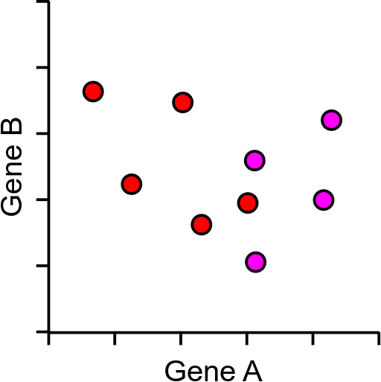
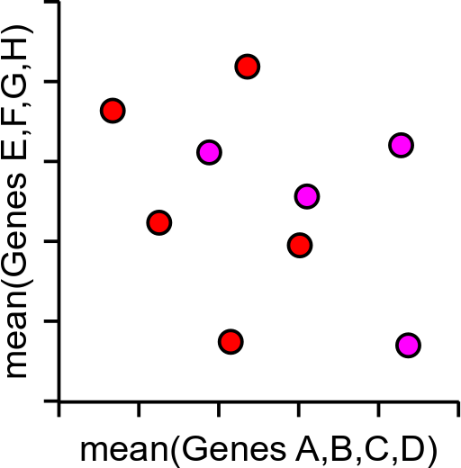
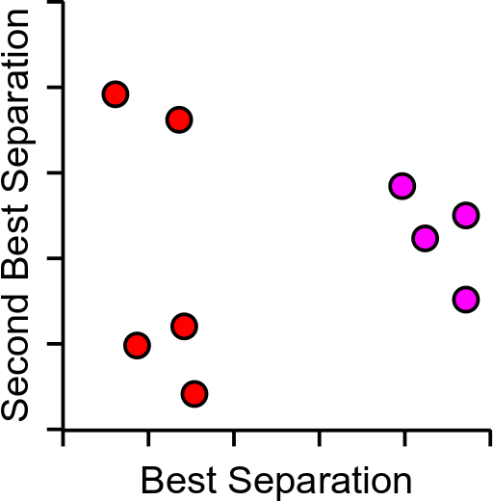
Too much data!
5000 cells and 2500 measured genes
Realistically only 2 dimensions we can plot (x,y)

Slide 4
Principle Components Analysis
Method to optimally summarise large multi-dimensional datasets
Can find a smaller number of dimensions (ideally 2) which retain most of the useful information in the data
Builds a recipe for converting large amounts of data into a single value, called a Principle Component (PC), eg:
PC = (GeneA*10)+(GeneB*3)+(GeneC*-4)+(GeneD*-20)…

Slide 5
Principle Components Analysis
Method to optimally summarise large multi-dimensional datasets
Can find a smaller number of dimensions (ideally 2) which retain most of the useful information in the data
Builds a recipe for converting large amounts of data into a single value, called a Principle Component (PC), eg:
PC = (GeneA*10)+(GeneB*3)+(GeneC*-4)+(GeneD*-20)…

Slide 6
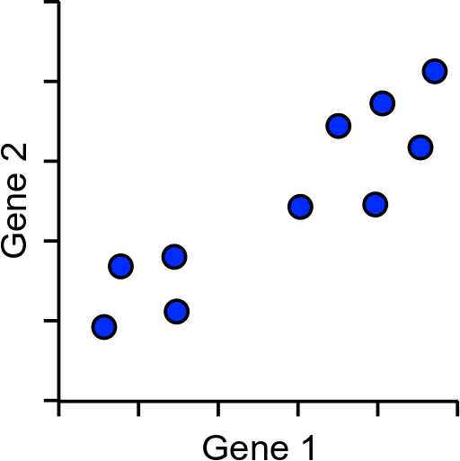
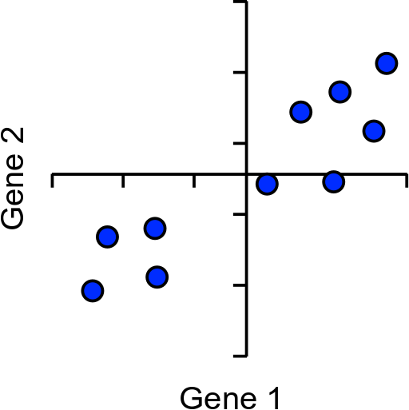
How does PCA work?
Simple example using 2 genes and 10 cells

Slide 7
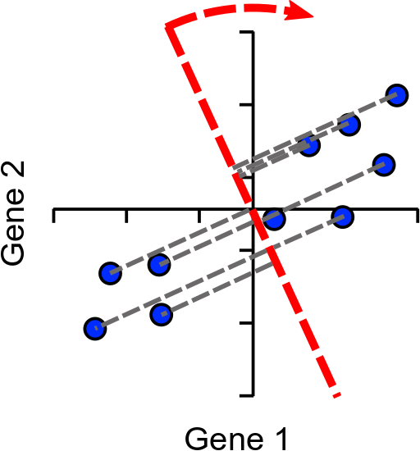
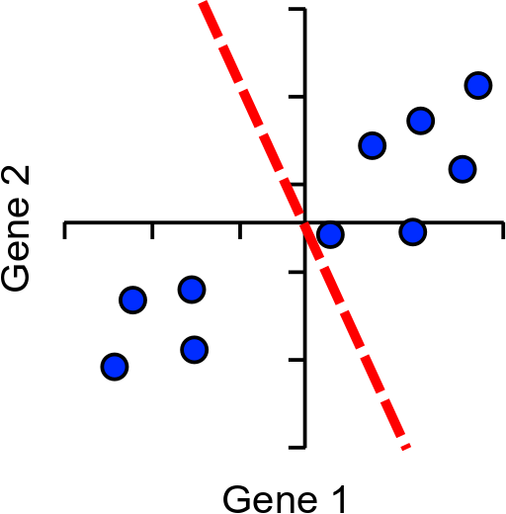
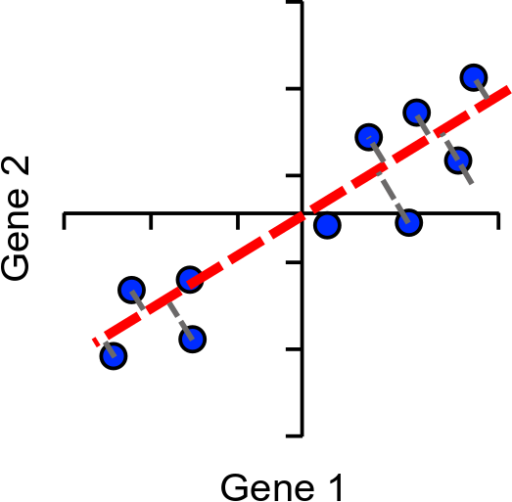
How does PCA work?
Find line of best fit, passing through the origin

Slide 8
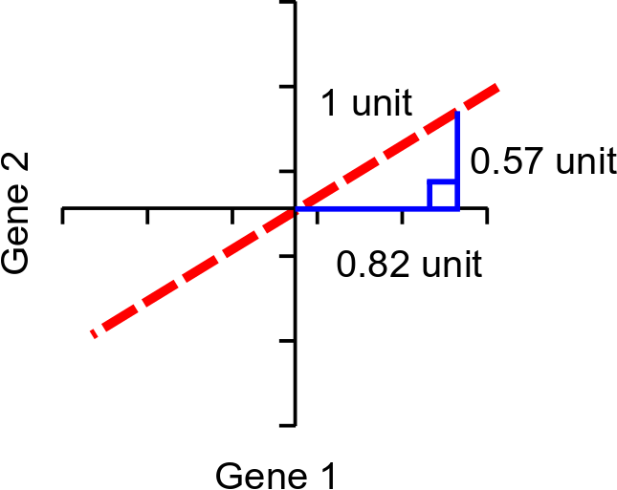
Assigning Loadings to Genes
Single Vector or
‘eigenvector’
Loadings:
Gene1 = 0.82
Gene2 = 0.57
Higher loading equals more influence on PC

Slide 9
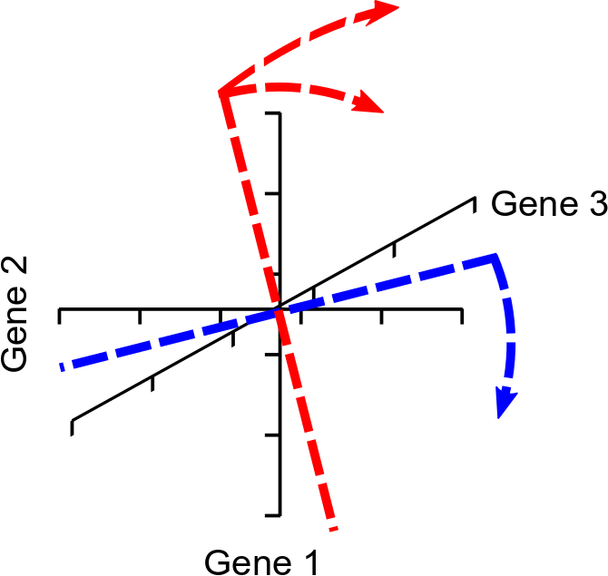
More Dimensions
The same idea extends to larger numbers of dimensions (n)
First PC rotates in (n-1) dimensions
Next PC is perpendicular to PC2, but rotated similarly (n-2)
Last PC is remaining perpendicular (no choice)
Same number of PCs as genes

Slide 10
Explaining Variance
Each PC always explains some proportion of the total variance in the data. Between them they explain everything
PC1 always explains the most
PC2 is the next highest etc. etc.
Since we only plot 2 dimensions we’d like to know that these are a good explanation
How do we calculate this?

Slide 11
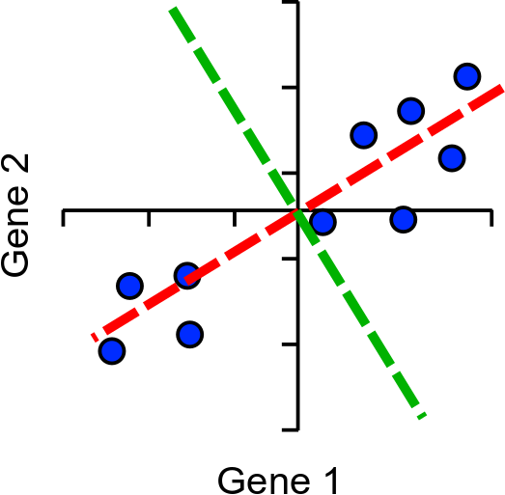
Explaining variance
Project onto PC
Calculate distance to the origin
Calculate sum of squared differences (SSD)
This is a measure of variance called the ‘eigenvalue’
Divide by (points-1) to get actual variance
PC1
PC2

Slide 12
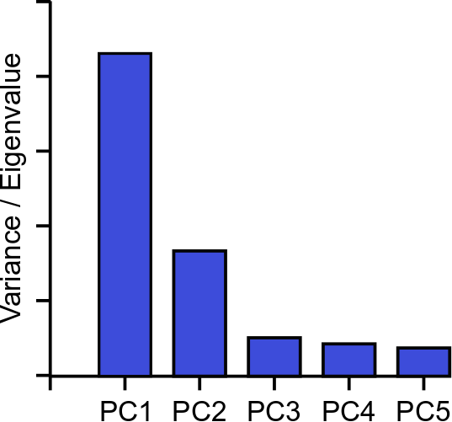
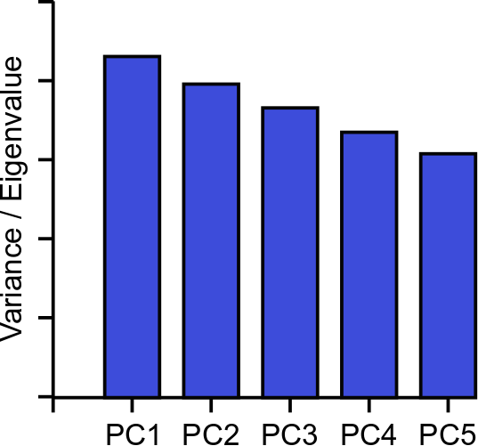
Explaining Variance – Scree Plots

Slide 13
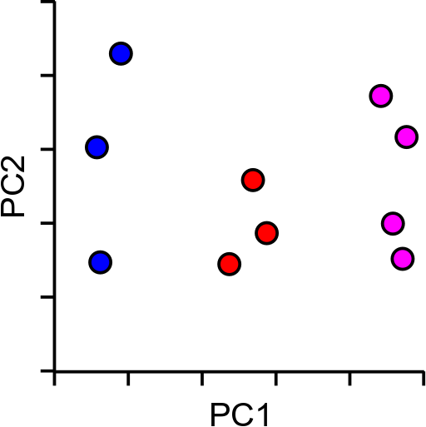
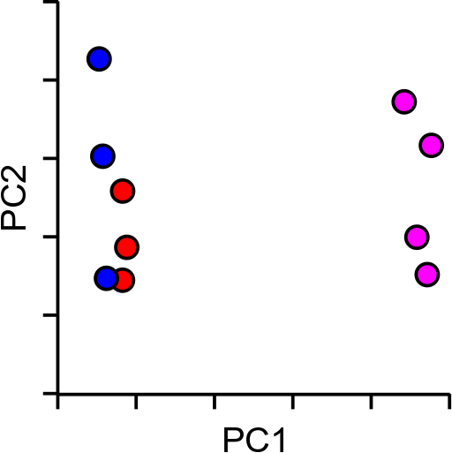
So PCA is great then?
Kind of…
Non-linear separation of values

Slide 14
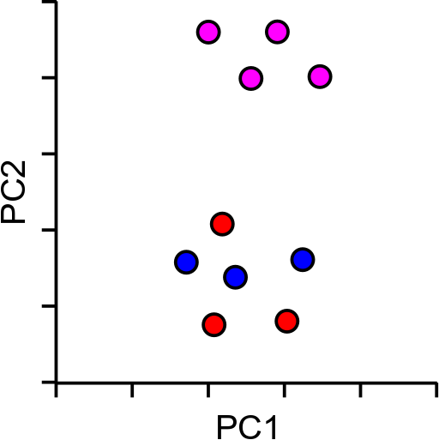
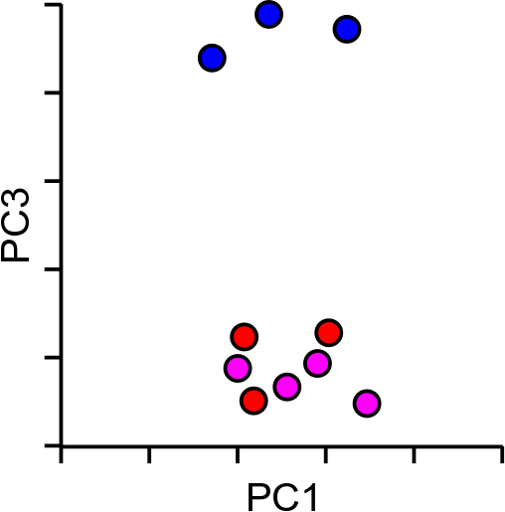
So PCA is great then?
Kind of…
Not optimised for 2-dimensions

Slide 15
tSNE to the rescue…
T-Distributed Stochastic Neighbour Embedding
Aims to solve the problems of PCA
Non-linear scaling to represent changes at different levels
Optimal separation in 2-dimensions

Slide 16
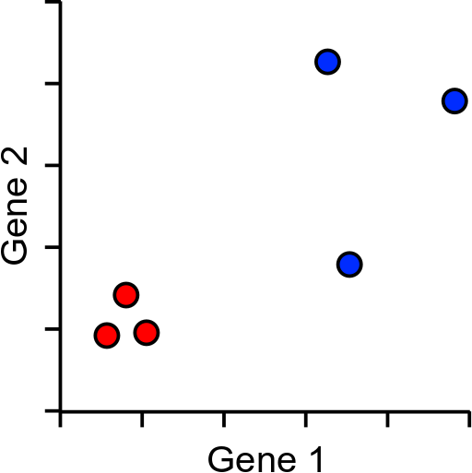
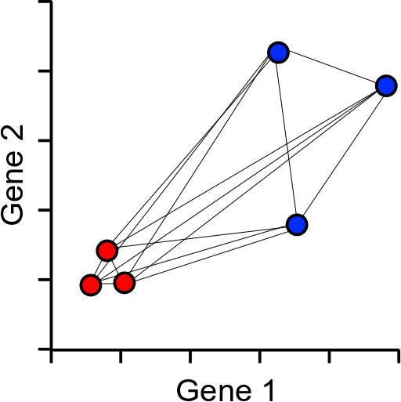
How does tSNE work?
Based around all-vs-all table of pairwise cell to cell distances

Slide 17
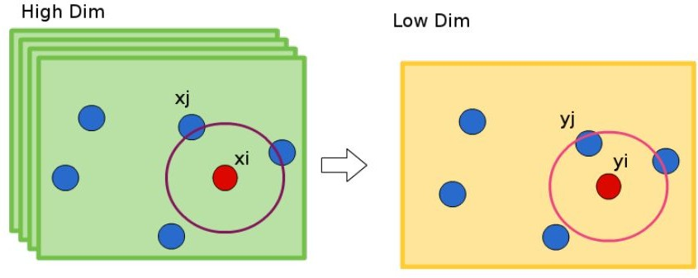
Underlying idea of t-SNE

Slide 18
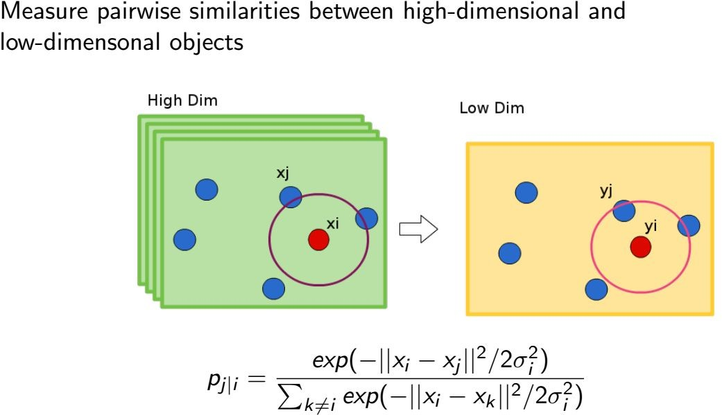
Stochastic Neighbor Embedding

Slide 19
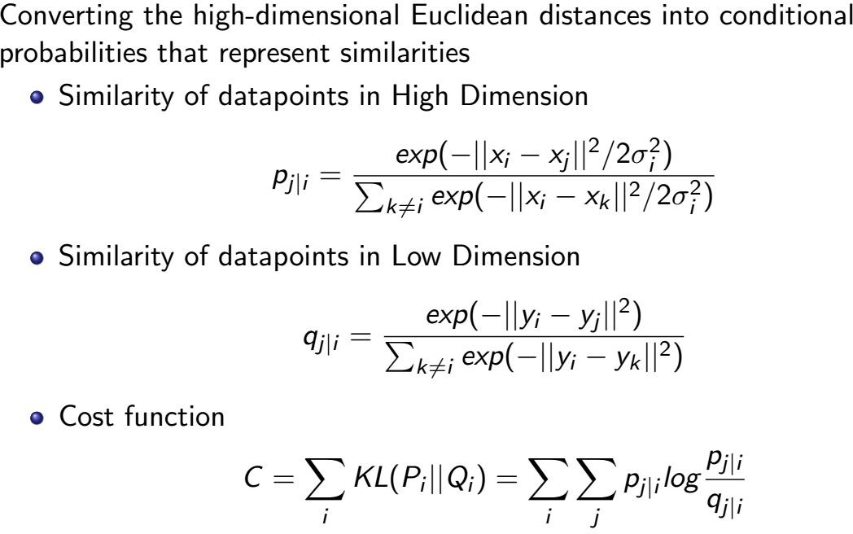
Stochastic Neighbor Embedding

Slide 20
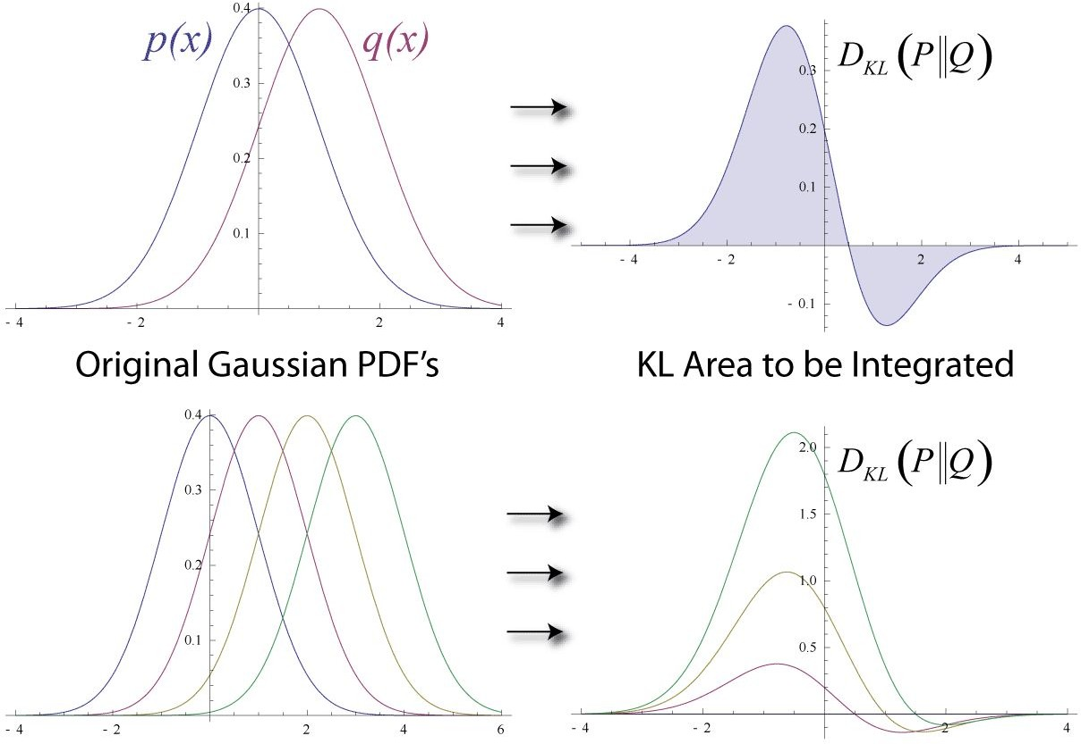

KL Divergence
Measures the similarity between two probability distributions & it is asymmetric

Slide 21
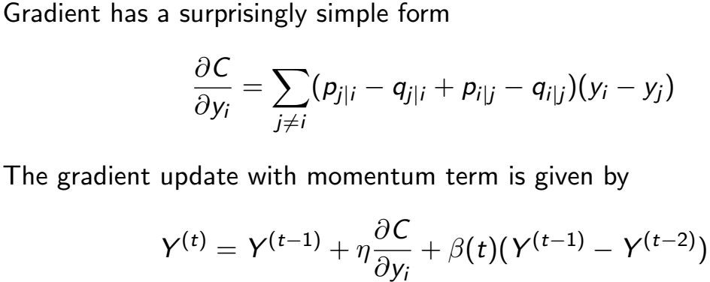
Stochastic Neighbor Embedding

Slide 22
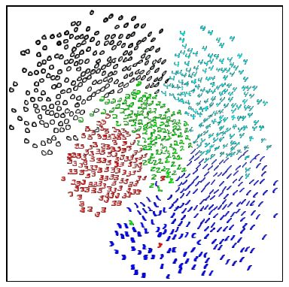
Stochastic Neighbor Embedding
The result of running the SNE algorithm on 3000
256-dimensional grayscale images of handwritten digits.
The classes are quite well separated even though SNE had no information about class labels. Furthermore, within each class, properties like orientation, skew and strokethickness tend to vary smoothly across the space.

Slide 23
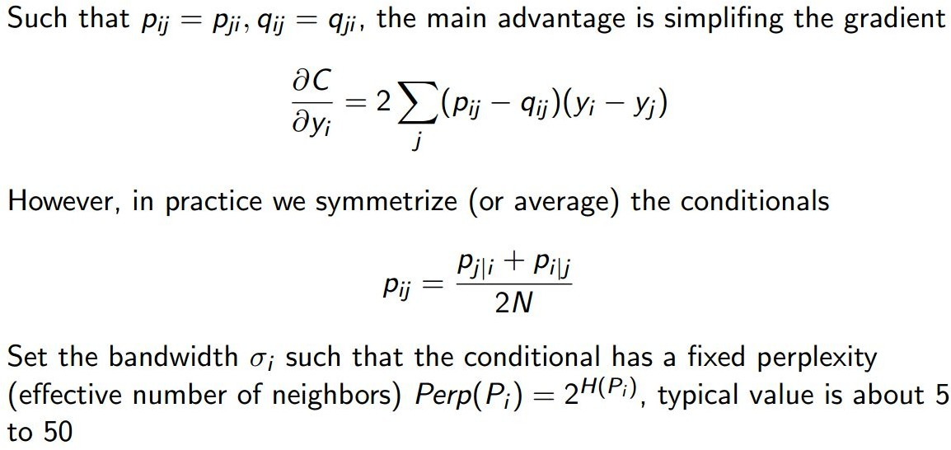
Symmetric SNE

Slide 24
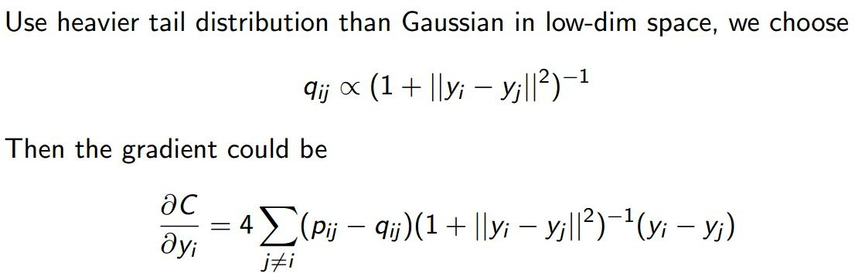
t-Distribution

Slide 25
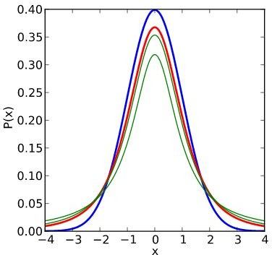

Why Student-t Distribution?
Why do we define map similarities as
Suppose data is intrinsically high dimensional
We try to model the local structure of this data in the map
Result: Dissimilar points have to be modeled as too far apart in the map!

Slide 26
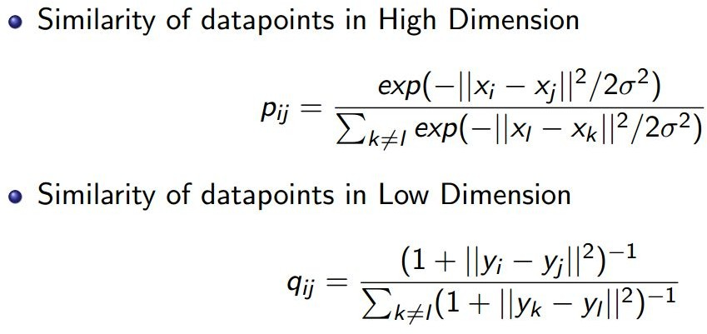
t-Distributed Stochastic Neighbor Embedding

Slide 27
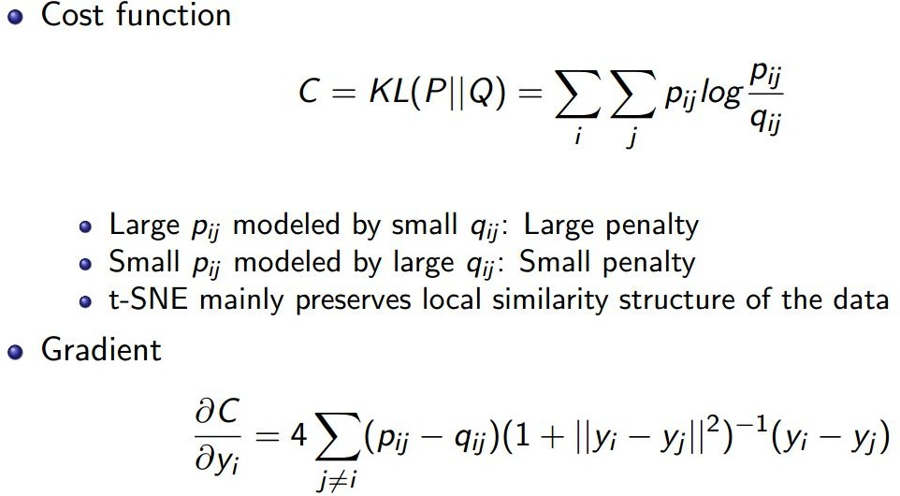
t-Distributed Stochastic Neighbor Embedding

Slide 28
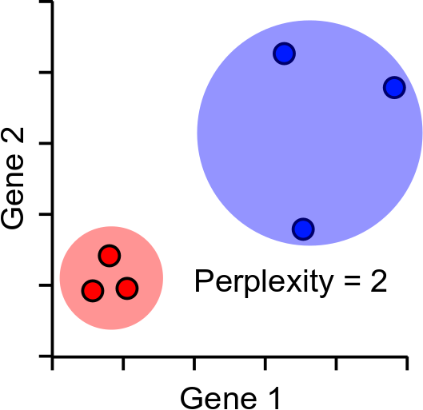
Distance scaling and perplexity
Perplexity = expected number of neighbours within a cluster
Distances scaled relative to perplexity neighbours

Slide 29
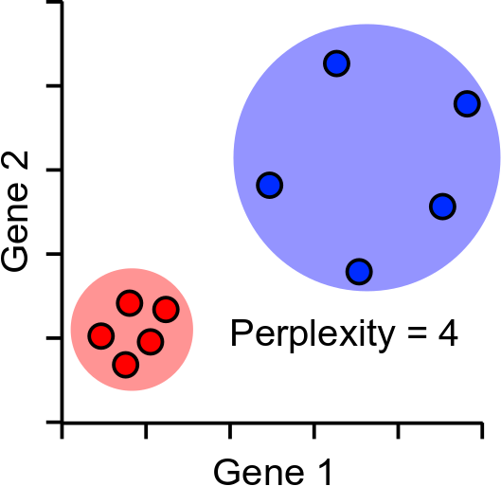
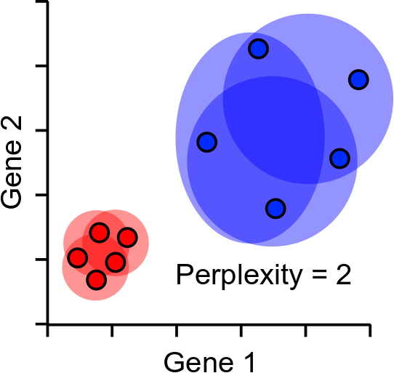
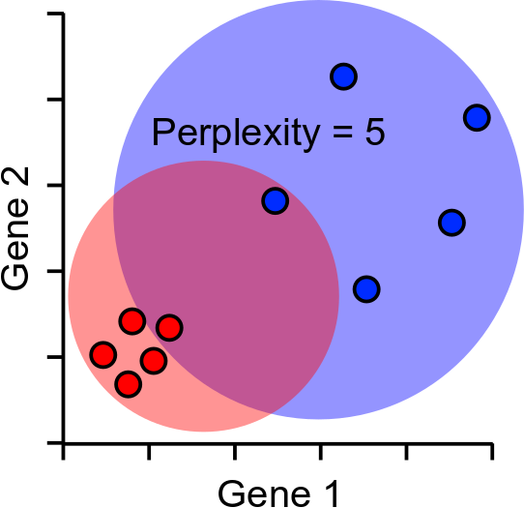
Perplexity Robustness

Slide 30
tSNE Projection
Randomly scatter all points within the space (normally 2D)
Start a simulation
Aim is to make the point distances match the distance matrix
Shuffle points based on how well they match
Stop after fixed number of iterations, or
Stop after distances have converged

Slide 31
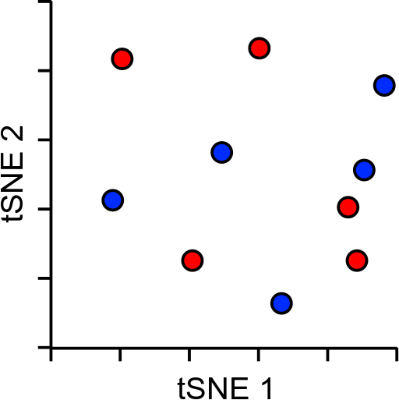
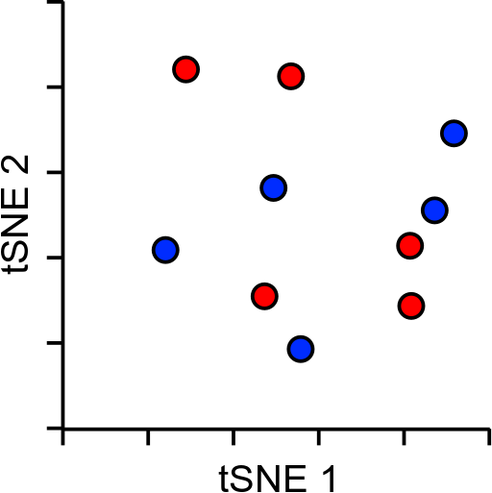
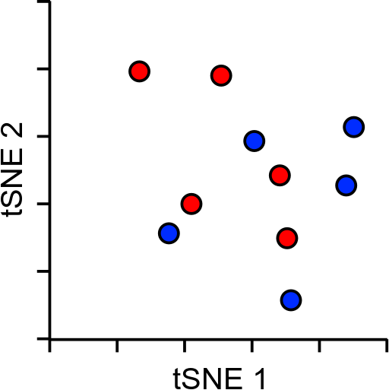
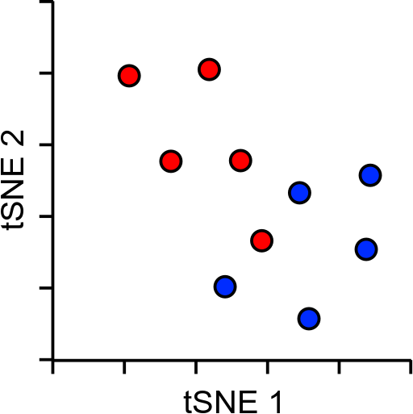
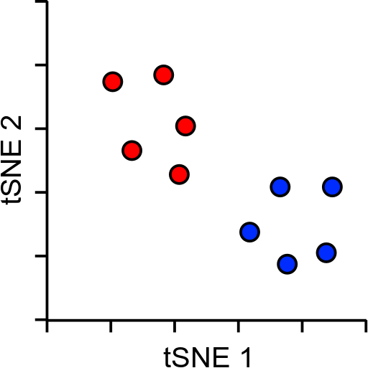
tSNE Projection
X and Y don’t mean anything (unlike PCA)
Distance doesn’t mean anything (unlike PCA)
Close proximity is highly informative
Distant proximity isn’t very interesting
Can’t rationalise distances, or add in more data

Slide 32
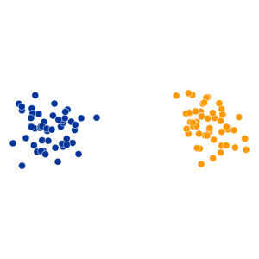
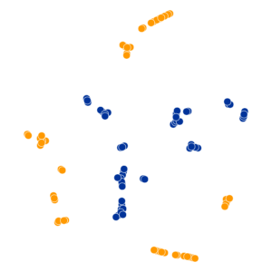
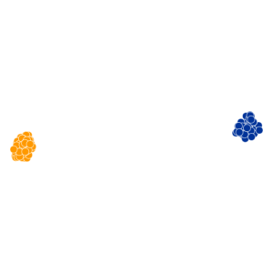
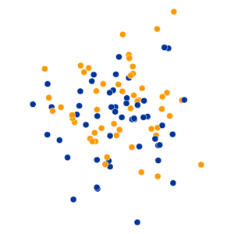
tSNE Practical Examples
Perplexity Settings Matter
Original
Perplexity = 2
Perplexity = 30
Perplexity = 100
https://distill.pub/2016/misread-tsne/

Slide 33
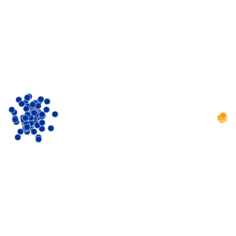
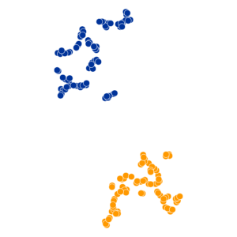
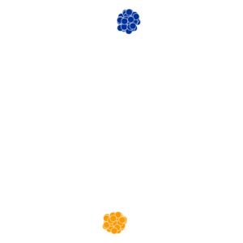
tSNE Practical Examples
Cluster Sizes are Meaningless
Original
Perplexity = 5
Perplexity = 50
https://distill.pub/2016/misread-tsne/

Slide 34
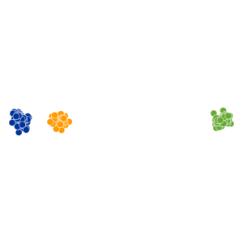
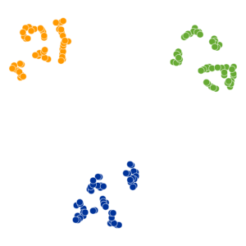
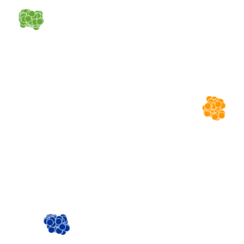
tSNE Practical Examples
Distances between clusters can’t be trusted
Original
Perplexity = 5
Perplexity = 30
https://distill.pub/2016/misread-tsne/

Slide 35

Results: MNIST

Slide 36


So tSNE is great then?
Kind of…
Imagine a dataset with only one super informative gene
Now 3 genes
Now 3,000 genes
Everything is the same distance from everything
Distance within cluster = low
Distance between clusters = high
Distance within cluster = higher
Distance between clusters = lower

Slide 37
So everything sucks?
PCA
Requires more than 2 dimensions
Expects linear relationships
tSNE
Can’t cope with noisy data
Loses the ability to cluster
Answer: Combine the two methods, get the best of both worlds
PCA
Good at extracting signal from noise
Extracts informative dimensions
tSNE
Can reduce to 2D well
Can cope with non-linear scaling
This is what many pipelines do in their default analysis

Slide 38
So PCA + tSNE is great then?
Kind of…
tSNE is slow. This is probably it’s biggest crime
tSNE doesn’t scale well to large numbers of cells (10k+)
tSNE only gives reliable information on the closest neighbours large distance information is almost irrelevant

Slide 39
UMAP to the rescue!
UMAP is a replacement for tSNE to fulfil the same role
Conceptually very similar to tSNE, but with a couple of relevant (and somewhat technical) changes
Practical outcome is:
UMAP is quite a bit quicker than tSNE
UMAP can preserve more global structure than tSNE*
UMAP can run on raw data without PCA preprocessing*
UMAP can allow new data to be added to an existing projection
* In theory, but possibly not in practice

Slide 40
UMAP differences
Instead of the single perplexity value in tSNE, UMAP defines
Nearest neighbours: the number of expected nearest neighbours – basically the same concept as perplexity
Minimum distance: how tightly UMAP packs points which are close together
Nearest neighbours will affect the influence given to global vs local information. Min dist will affect how compactly packed the local parts of the plot are.

Slide 41


UMAP differences
Structure preservation – mostly in the 2D projection scoring
Scoring
(penalty)
value
Distance in
projected data
Distance in
original data
tSNE
UMAP
https://towardsdatascience.com/how-exactly-umap-works-13e3040e1668

Slide 42

So UMAP is great then?
Kind of…
tSNE
UMAP

Slide 43

So UMAP is all hype then?
No, it really does better for some datasets…
3D mammoth skeleton projected into 2D
tSNE: Perplexity 2000 2h 5min
UMAP: Nneigh 200, mindist 0.25, 3min
https://pair-code.github.io/understanding-umap/

Slide 44
Practical approach PCA + tSNE/UMAP
Filter heavily before starting
Nicely behaving cells
Expressed genes
Variable genes
Do PCA
Extract most interesting signal
Take top PCs. Reduce dimensionality (but not to 2)
Do tSNE/UMAP
Calculate distances from PCA projections
Scale distances and project into 2-dimensions

Slide 45

So PCA + UMAP is great then?
Kind of… as long as you only have one dataset
In 10X every library is a 'batch'
More biases over time/distance
Biases prevent comparisons
Need to align the datasets

Slide 46
References
These slides have been adapted from
Zaur Fataliyev, Seoul AI
Simon Andrews, Dimensionality Reduction, Babraham Bioinformatics

